Slide 1


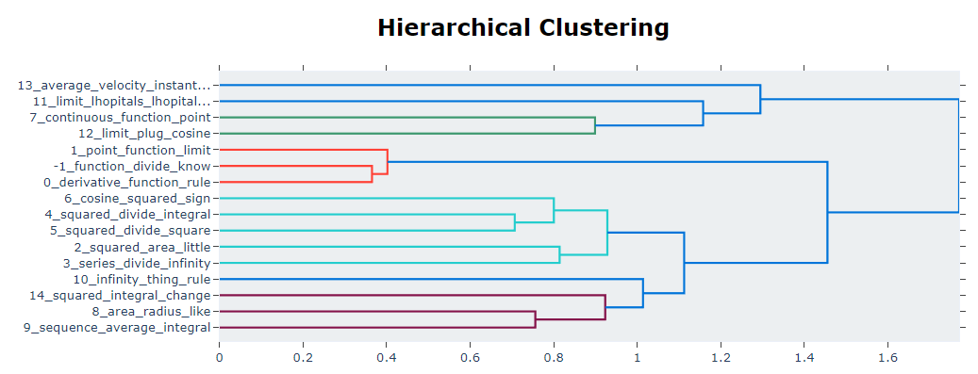
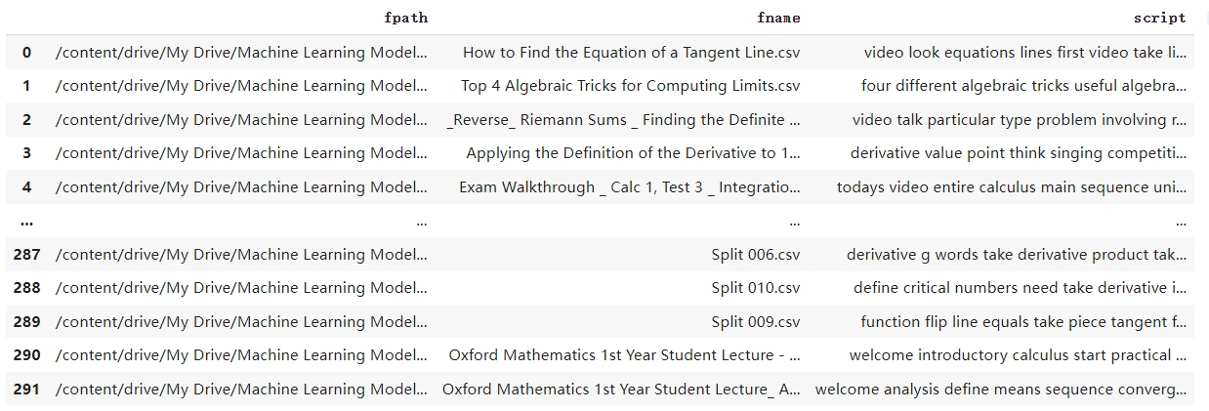
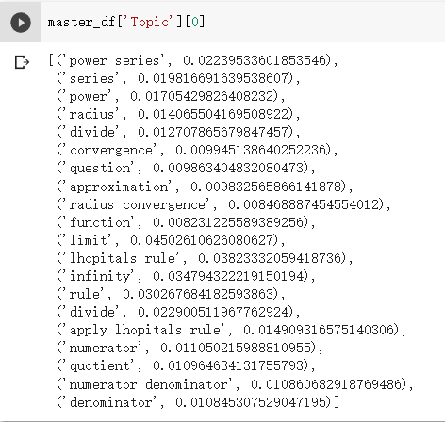
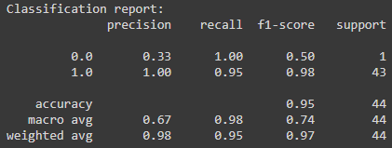
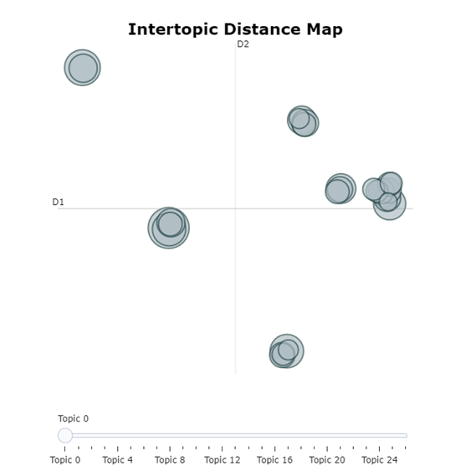
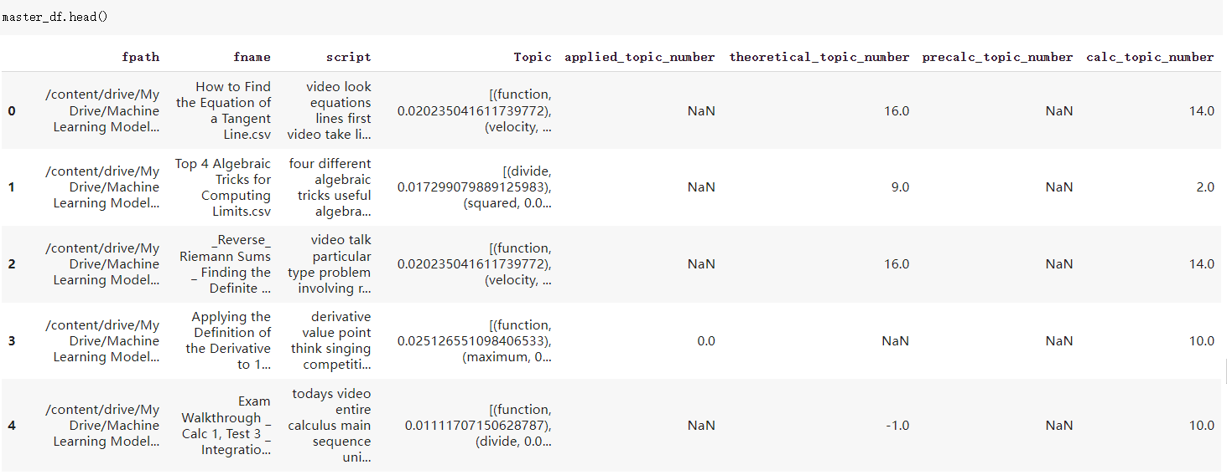
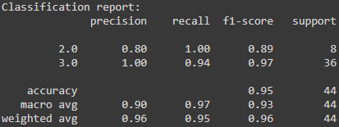
Classification of Educational Videos by Machine Learning
Dr. Xiaoxia “Jessica” Xie, David Lindeman, Ziming Wang
Department of Mathematics and Statistics, Idaho State University, Pocatello, ID 83209
Introduction
We need to add some tags to our scripts for later supervised and unsupervised model training. Additionally, this can differentiate individual scripts from their clusters when primary keywords are added to the data frame. We obtained the top 20 keywords assigned to scripts using the keyBERT model. After using the keyBERT model for the first time, we found that the top 20 keywords in each script are not all related to math terms. Therefore, we created a math keywords corpus. There are about 260 words in this math keywords corpus. So we get the top 20 math keywords as the labels by combining keyBERT and math keywords. These math keywords also indirectly increase the weight of other mathematical terms and topics and improve the accuracy of the results in the BERTopic model.
XGBoost model allowed us to quickly build our pipeline to process the data and gave us easy access to other tools that helped us with our process. During this phase, we hand-categize our data to create two sets of partitions, one for teaching style and another for the mathematical subject. We found that they were focused on calculus or precalculus in these videos. We cleaned and tested our data using the XGBoost pipeline. We found that 10% gave us the best results. The next step in our process was to handle the imbalance of our data; we found that only ~5% of scripts were applied, while 95% were theoretical. Additionally, we found that ~78% were calculus, and only ~22% were precalculus. This required us to train our model to handle the imbalances. We implemented the SMOTE tool, which allowed us to pad our data during the testing phase to represent our minority partition better.
Ultimately, this allowed us to accurately predict our data with a ~95.5% accuracy for both style and subject. The classification reports in figure 3 and figure 4 below show us a more detailed view of our tests.
BERTopic is a topic modeling technology that uses BERT embedding and class-based TF-IDF to create clusters, making topics easy to explain while retaining essential vocabulary in topic descriptions. Its steps are mainly to do three things: 1) Use BERT-based Sentence Transformers to extract sentence embeddings. 2) Through UMAP and HDBSCAN, the documents are embedded for clustering, and the sentences with similar semantics are clustered into clusters. 3) Use c-TF-IDF to extract topics.
We used the BERTopic to extract keywords from all scripts. Each script will be assigned three-gram topic words. According to each topic, we can get the mathematical terms.
Hierarchical Clustering are all clustering algorithms in the BERTopic model. Hierarchical Clustering creates a hierarchical clustering tree by calculating the similarity between different types of topics. After we use the BERTopic Model to extract some topics, BERTopic can use the hierarchical clustering method to understand the potential hierarchical structure of the topics, create clusters, and visualize the relationship between them. The topics created in this way can be hierarchically reduced, and visualize the similarity and relationships between different topics.
Civita Laurea is an educational platform that wants to analyze teaching styles from videos, and the goal is to detect some features from them in order to be able to define those teaching styles. The purpose of our project was to cluster a set of scripts from educational mathematical videos and find the topic for each video.
we began with preliminary research on the topic of Natural Language Processing. Natural language processing (NLP) refers to concerned with giving computers the ability to understand the text and spoken words in much the same way human beings can.
Topic modeling is unsupervised learning technology. By using topic modeling, each document can be assigned some topic without being pre-labeled for scripts. Since the topic modeling will automatically analyze each document, count the words, and determine which topics the current document contains and the proportion of each topic based on the statistical information, we do not need to pre-labeled for scripts.
Figure 6: The Hierarchical Clustering of Calculus Subject
Conclusions
In short, we cleaned the scripts and removed some irrelevant words. We used a supervised model, the XGBoost model, to create the two separate sets of partitions. Then, an unsupervised model was applied to each set of partitions to cluster the scripts further. Each script was assigned keywords based on their clusters during the unsupervised model clustering phase. The final step was to run a standalone unsupervised model, which is the BERTopic model on each script to distill the most essential keywords from each script. Our end product was a set of related scripts with specific script tags and classification tags.
Data Set
Our script comes from the subtitle file of educational mathematical videos. Therefore, each video has a script. But in the beginning, we don't have any labels for our scripts. Our data frame only has the subtitle file's title, path, and contents.
Figure 1: The original data set from educational videos on Mathematics.
Figure 3: Teaching style classification report
Models and Discussion
KeyBERT is a small and easy-to-use keyword extraction technology that uses BERT embedding and simple cosine similarity to find the most similar words in the document.
Figure 2: After using keyBert, each script can get a list of math keywords with weight. We named it a new column called topic.
Figure 4: Subject classification report
Figure 5: The clusters of BERTopic model
Figure 7: Final result, and each script has four categories of numbers to represent the weight of the script in each category.

